Slide 1

Car Booking System
Final Evaluation
Presenter
Pranoy Bhan
(2020a1r114)
CSE -Department
DEPARTMENT OF COMPUTER SCIENCE AND ENGINEERING
MIET(Autonomous), JAMMU

Slide 2
Contents
Internship Information
Training Topic
What I learnt about the python during my internship
Problem Statement
Solution
Tech Stack
Features
Workflow
Demonstration

Slide 3


TRAINING TOPICS
Training consists of Three parts:
Python
Tkinter
SQLite

Slide 4
Training Topics
Introduction
Features
Setting up path
Working with Python
Basic Syntax
Variable and Data Types
Operator
Conditional statement
If
If- else
Nested if-else
Looping
For
While
Nested loops
Control Statements
Break
Continue
Pass
String Manipulation
Accessing Strings
Basic Operations
String slices
Function and Method
Data Structure
List
Tuple
Dictionary
Function
Defining a function
Calling a function
Types of functions
Function Arguments
Anonymous functions
Global and local variables
Modules
Importing module
Math module
Random module
Packages
Composition
OOPS
Class and object
Attributes
Inheritance
Overloading
Overriding
Data Hiding
Exception Handling
Exception
Exception Handling
Except clause
Try-finally clause
User Defined Exceptions

Slide 5
Training Topics(Continued)
Database
Introduction
Connections
Executing queries
Transactions
Handling error
GUI Programming
Introduction
Tkinter programming
Tkinter widgets
We have used topic like OOPS,Exception handling,Tkinter,Database for creating our project which we will see in detail in further slides

Slide 6
Problem Statement
The process of car booking manually has always been a complicated task.
Issues in traditional System:
-Risk of human error
-Manual booking is time-consuming
-Too much paperwork

Slide 7
Solution
Our system would be able to monitor and track the number of bookings that are created by the user.
The system can keep the booking records and also appointment time .
The user create their appointment by itself which help the customer to save their precious time .

Slide 8
Tech Stack
Python
SQL
Tkinter

Slide 9
Features
Real time monitoring
Appointment and Booking Module
Manage Booking Details
It avoids the long waiting period.
Dealer and customer Dashboard.
Audio Demonstration

Slide 10
WORKFLOW

Slide 11
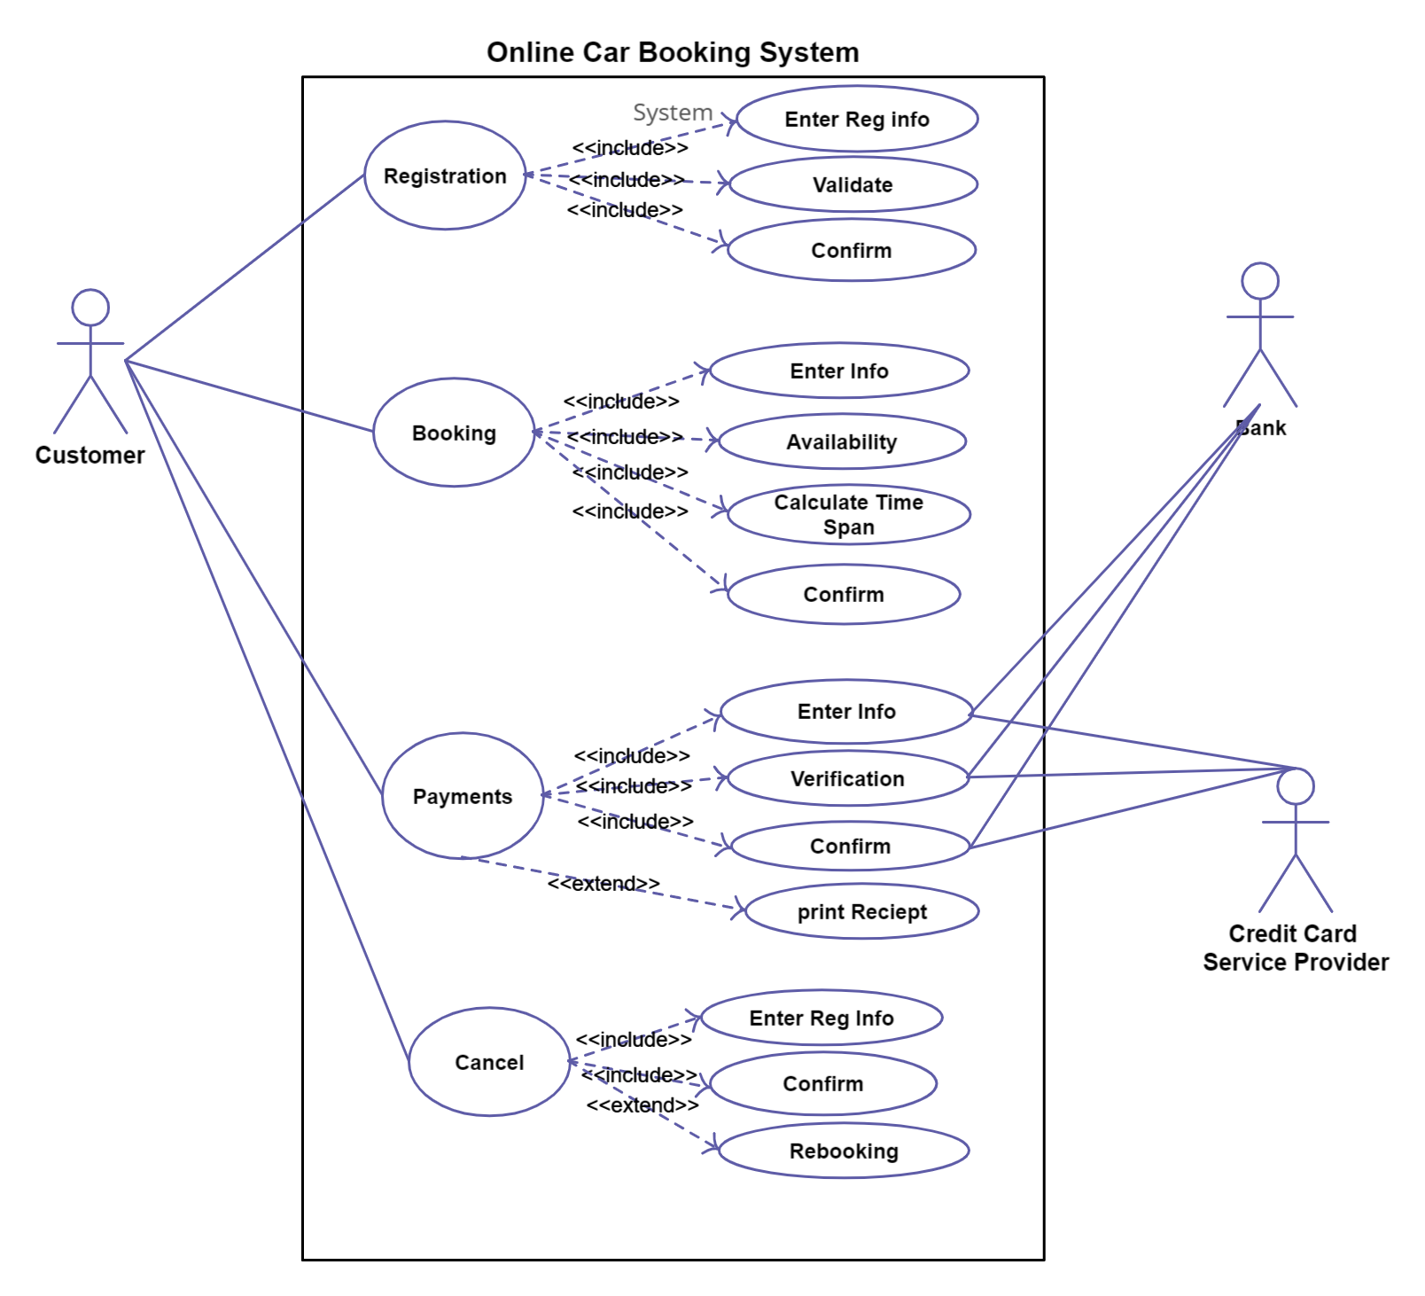
WORKFLOW

Slide 12
DEMONSTRATION

Slide 13
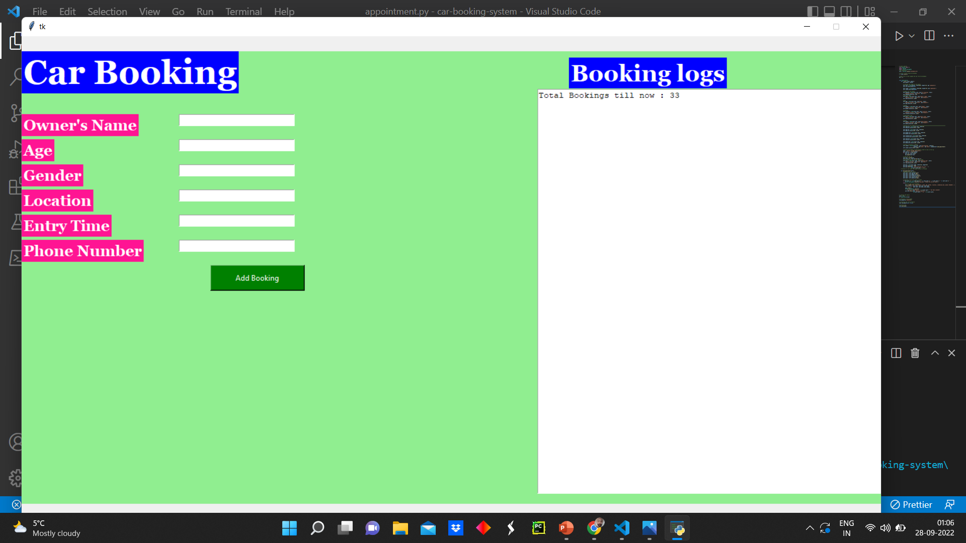

Slide 14
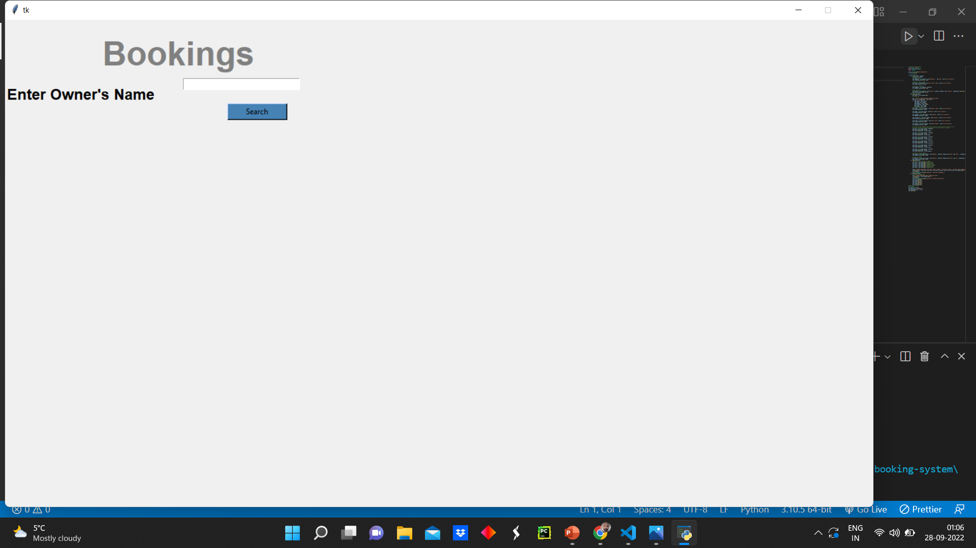

Slide 15


